Slide 1
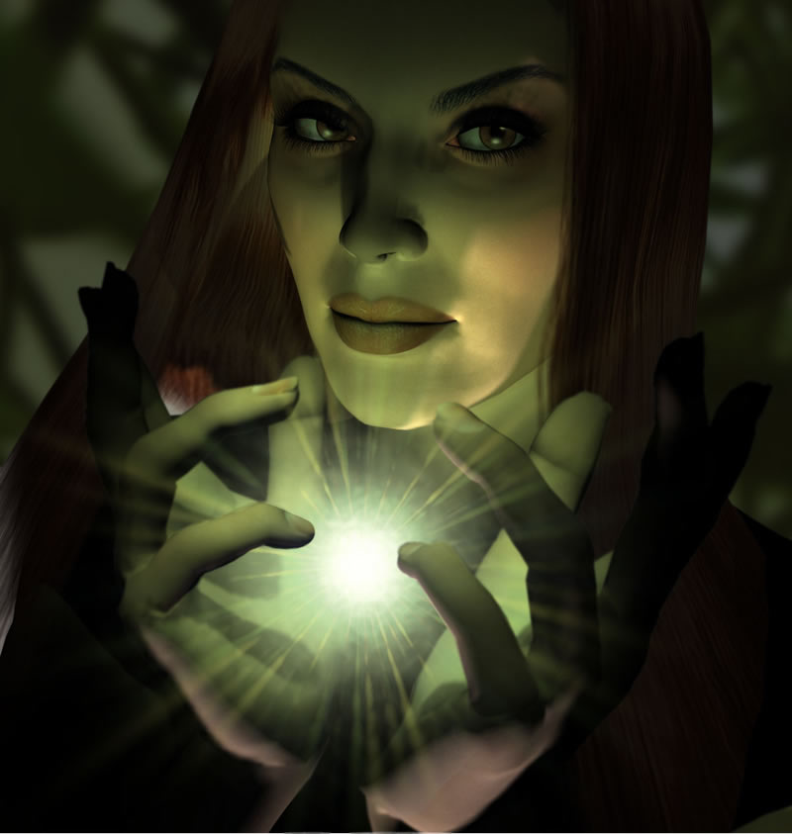
A Kingdom Removed
(Rev. 17:1–19:10)
396
Dr. Rick Griffith • Crossroads International Church Singapore • cicfamily.com • BibleStudyDownloads.org

Slide 2
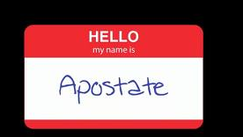
Apostates don't wear nametags

Slide 3

Apostates Destroy From Within

Slide 4
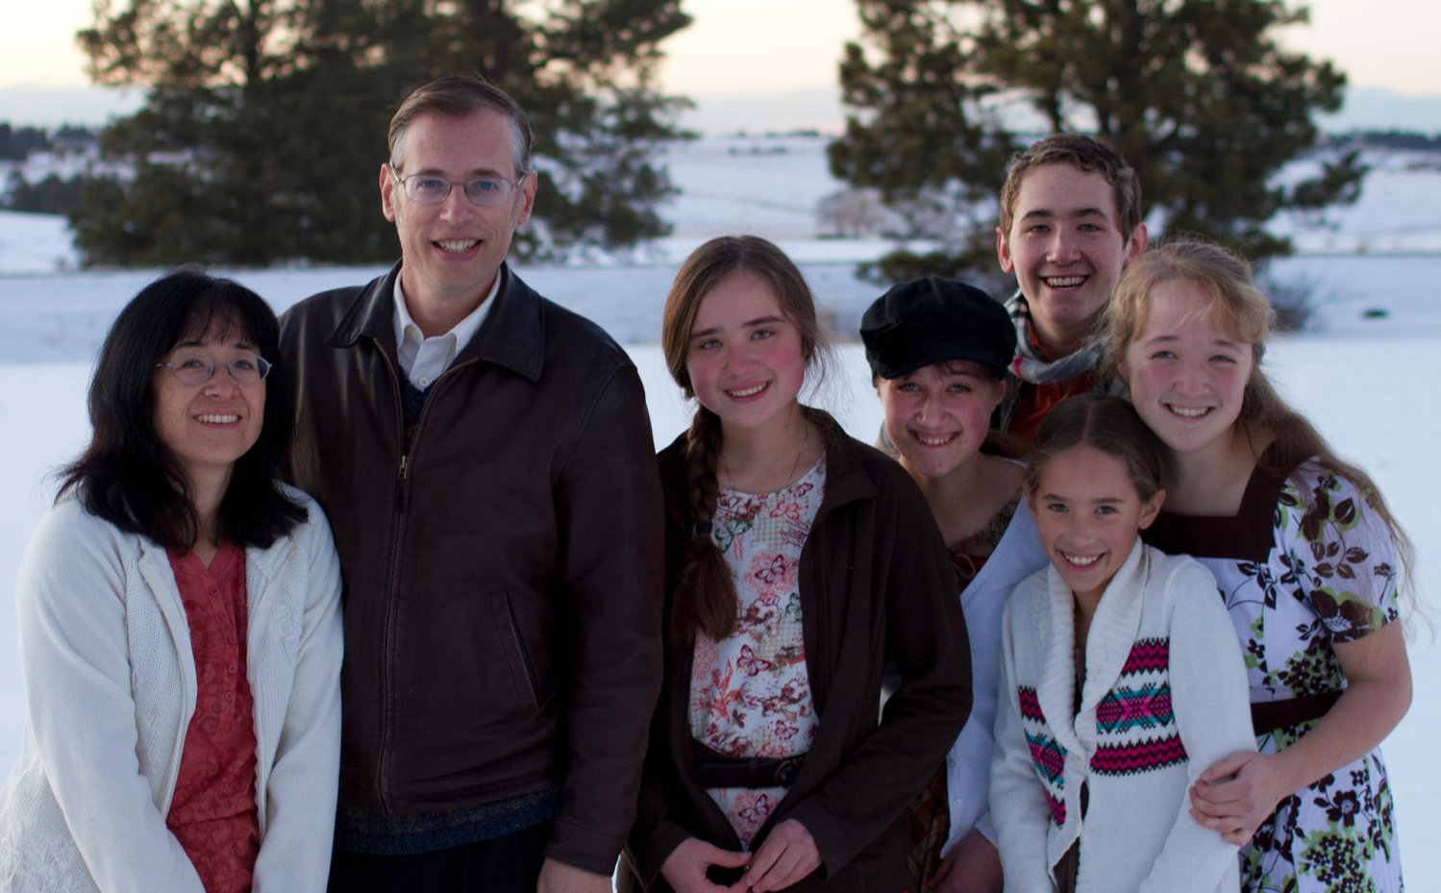
The Book Apostate
Kevin Swanson and his family

Slide 5
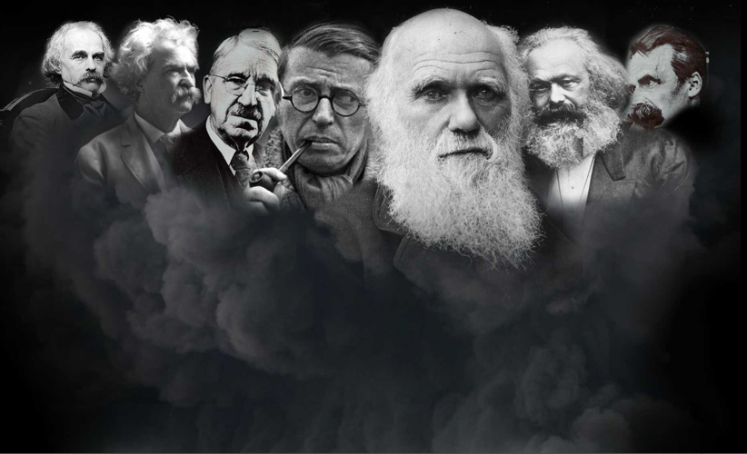
Who are the apostates?
Charles Darwin
Nathaniel Hawthorne
John Dewey
Friedrich Nietzsche
Mark Twain
Karl Marx
Jean-Paul Sartre
Ernest Hemingway
Lady Gaga

Slide 6

Why are they significant?
"This is the story of the decline and fall of Western civilization. It is the story of uncommonly powerful men, unfathomably evil men. . . apostates."
–Kevin Swanson

Slide 7
What did the apostates teach?
Charles Darwin
Nathaniel Hawthorne
John Dewey
Friedrich Nietzsche
Mark Twain
Karl Marx
Jean-Paul Sartre
"Eliminate home schools!"
"There is no God!"
"God didn't create. We evolved!"

Slide 8
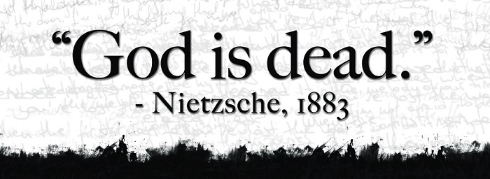
Godless Philosophy
"God is dead."
– Nietzsche, 1883
"Nietzsche is dead."
– God, 1900
Used with permission

Slide 9
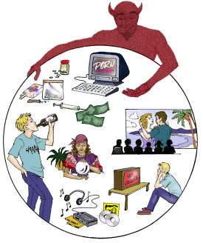
How are you doing with resisting the world and welcoming Christ?

Slide 10
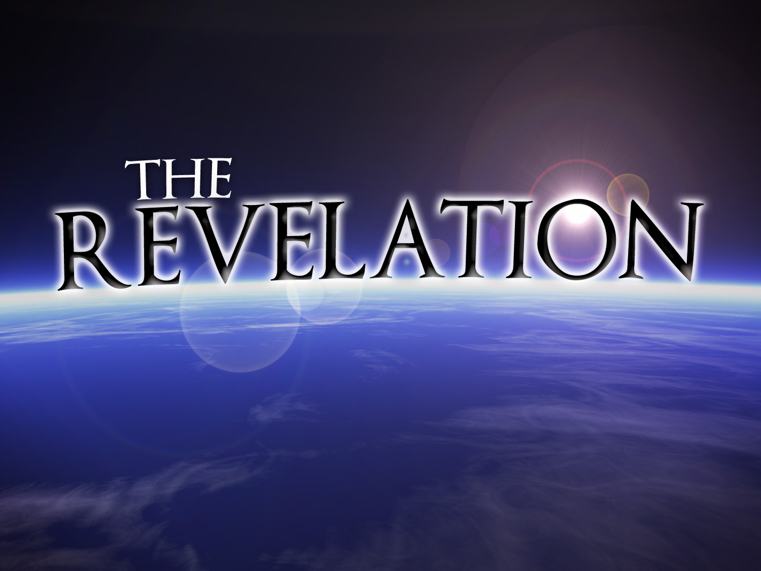
Why should we reject the world…
…and embrace God's kingdom?

Slide 11

Content of the Judgments
337
 | SEALS | TRUMPETS | BOWLS
1 | White: conqueror | Hail & fire: 1/3 vegetation | Sores
2 | Red: war | Fire: 1/3 sea creatures | Sea to blood
3 | Black: famine | Star: 1/3 fresh water | Fresh water to blood
4 | Pale: death | Dark: 1/3 sun, moon, stars | Sun burns men
 |  | (Trumpets 5-7 are woes)
5 | Martyrs reassured | Woe #1: locusts | Beast's kingdom dark
6 | Wrath: earthquake, signs | Woe #2: Euphrates prep | Euphrates dries up
 | (144,000 sealed) | (Trump #7 = mystery)
7 | 1/2 hour silence | Woe #3: victory imminent | Earthquake & hail
H O R S E S
W O E S
Adapted from Robert Gromacki, NT Survey and H. Wayne House, Chronological & Background Charts of the NT, 19

Slide 12
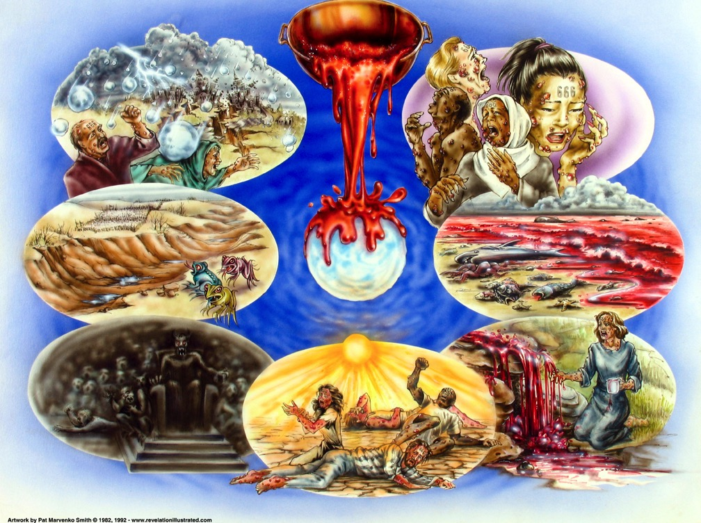
Bowl Judgments (Rev. 16)
392
Used with permission

Slide 13

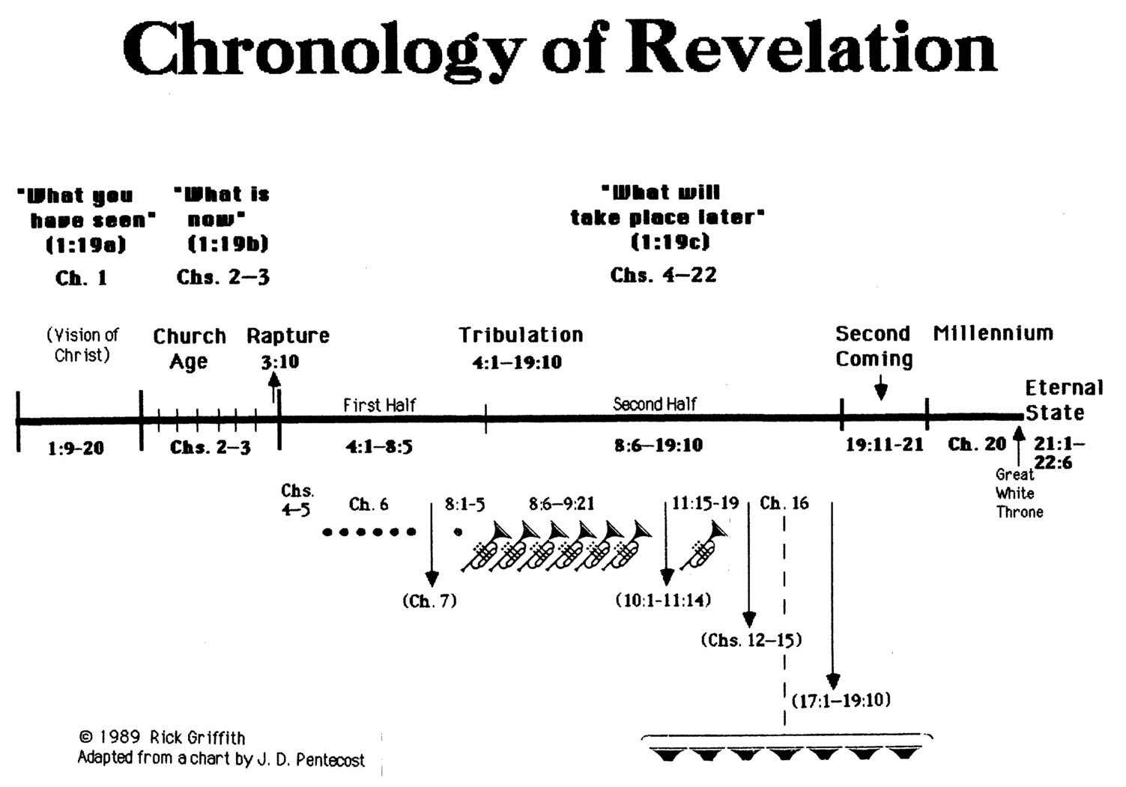
Chronology of Revelation
340
"What you have seen"
(1:19a)
Rev. 1
"What is
now"
(1:19b)
Rev. 2–3
"What will
take place later"
(1:19c)
Rev. 4–22
Vision of Christ
Church
Age
Rapture
3:10
Tribulation
4:1 – 19:10
Second Coming
Millennium
First Half
Second Half
Eternal State
Great White Throne Judgment
Copyright 1989 Rick Griffith
Adapted from a chart by J. D. Pentecost
Notes:
The 3 main divisions of Revelation are summarized in 1:19
The 3 main cycles of judgment are squared in blue
The 4 parenthetical sections appear in parentheses within the scrolls. They do not advance the chronology but add important information that is not associated with a particular judgment.

Slide 14
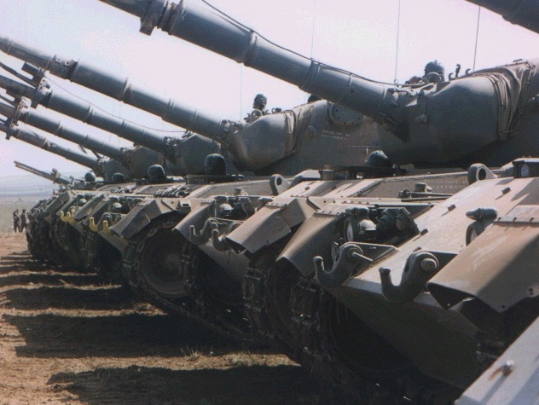
Note:
The Tribulation has ended. Now a word from our Sponsor…
395

Slide 15

"Babylon"
What we should do about it (Rev. 18:1–19:10)?
What will happen to her
(Rev. 17)?

Slide 16
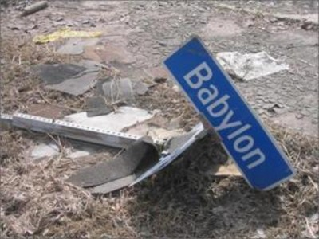
I. This world's key entity will fall in the Tribulation (Rev. 17).
What will happen to the world's most evil influence?

Slide 17
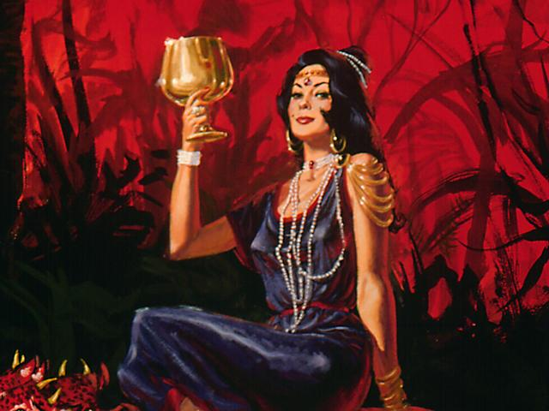
The Harlot (17:1-2 NLT)
"One of the seven angels who had poured out the seven bowls came over and spoke to me. 'Come with me,' he said, 'and I will show you the judgment that is going to come on the great prostitute, who rules over many waters.
396
²The kings of the world have committed adultery with her, and the people who belong to this world have been made drunk by the wine of her immorality.'"

Slide 18
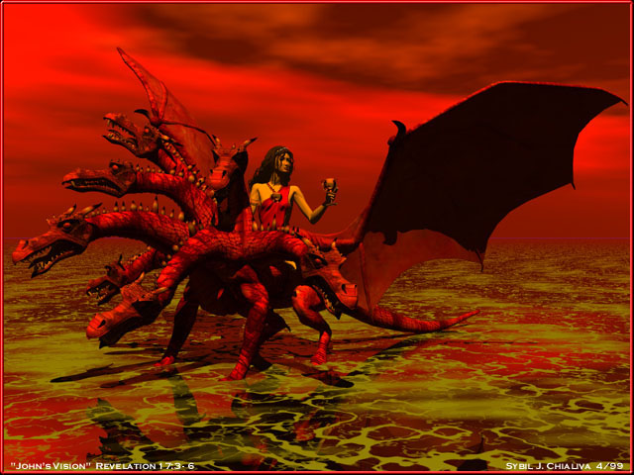
The Prostitute & Beast
396
"So the angel took me in the Spirit into the wilderness. There I saw a woman sitting on a scarlet beast that had seven heads and ten horns, and blasphemies against God were written all over it" (17:3 NLT)

Slide 19
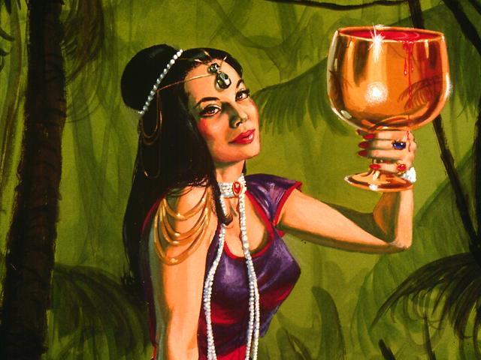
Beautiful but Immoral
"The woman wore purple and scarlet clothing and beautiful jewelry made of gold and precious gems and pearls. In her hand she held a gold goblet full of obscenities and the impurities of her immorality"
(17:4 NLT)
396

Slide 20
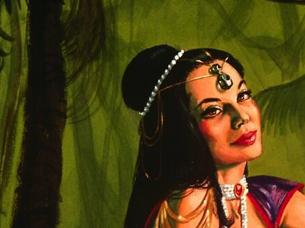
Babylon (17:5-6)
"A mysterious name was written on her forehead:
'Babylon the Great,
Mother of All Prostitutes and Obscenities in the World.'
⁶I could see that she was drunk—drunk with the blood of God's holy people who were witnesses for Jesus. I stared at her in complete amazement."
396

Slide 21

Belshazzar Humbled (Dan. 5:30)
396
Rembrandt
Notes:
Daniel read the handwriting on the wall to tell King Belshazzar that his days were numbered. Actually, his HOURS were numbered! That very night King Belshazzar died (Dan. 5:30) as a reminder that when God calls an end to a city, it can fall very quickly. Such will be the case with any leader or nation who rises up against Almighty God—including the End Times Babylon!

Slide 22



Fall of Babylon
396
Fall of Babylon
BABYLON FELL (539 BC)
Cyrus entered under the water gates
The End Times Babylon will not last either!
Daniel 5
(Belshazzar's Feast)
Notes:
Most ancient cities fell only after a siege lasting many months. Many thought that Babylon could never be conquered with its double walls, moat, and many towers.
However, Ancient Babylon fell in one evening by the Persians simply diverting the Euphrates River so that soldiers could enter under the water gates and open the doors to the rest of the army.

Slide 23
Who are These Major Players of Rev. 17?
397
The Prostitute (17:1-6)
Babylon (17:5)
The Great City over the earth (17:18)
The Beast (17:3a, 7-8)
The 8th King (17:11)
The 7 Heads (17:3b, 7)
The 7 Hills (17:9)
The 7 Kings (17:10)
The 10 Horns (17:3c, 7, 16)
The 10 Kings (17:12-13)
But are there really 10 players?

Slide 24
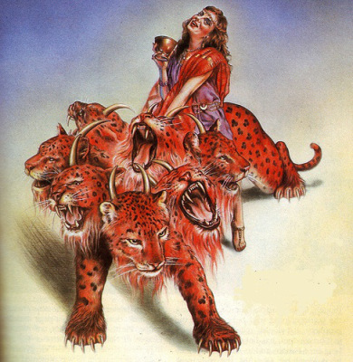
Identical Symbols of Rev. 17
398
Prostitute
(17:1)
Babylon, the Great City
(17:5, 18)
=
Beast
(17:3a)
Antichrist, the 8th King
(13:1; 17:11)
=
7 Heads
(17:7)
7 Hills (17:9)
=
7 Kings (17:10)
10 Horns
(17:3c,
7, 16)
10 Kings
(17:12-13)
=

Slide 25
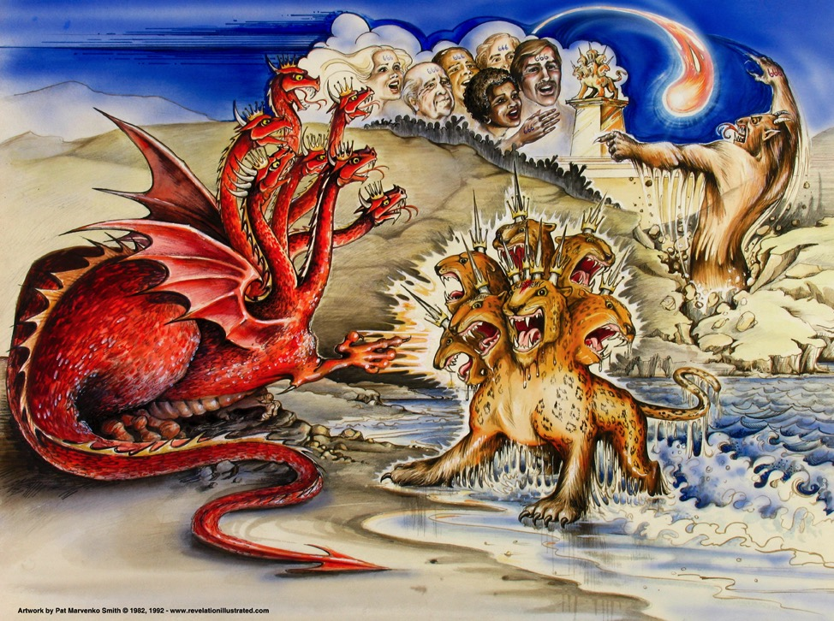
Beasts of Rev. 13
387
Dragon =
Satan
Land Beast =
False Prophet
Sea Beast =
Antichrist
Used with permission
Notes:
Slide 83 is adapted from Rev 1 intro slide
Slides 84-91 copied from Rev 20-22 presentation

Slide 26
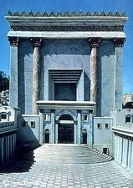

Who are the seven kings (17:9-10)?
39-41, 320
"This calls for a mind with understanding: The seven heads of the beast represent the seven hills where the woman rules. They also represent seven kings. ¹⁰ Five kings have already fallen, the sixth now reigns, and the seventh is yet to come, but his reign will be brief" (NLT).
Christ Crucified
AD 33
Jerusalem Destroyed
AD 70
Revelation Written
AD 95
Tiberius
14-37
Caligula
37-41
Claudius
41-54
Nero
54-68
Vespasian
69-79
Titus
79-81
Domitian
81-96
Notes:
Emperors in black persecuted Christians
This course teaches that Revelation was written during the reign of Domitian at the end of the first century.

Slide 27
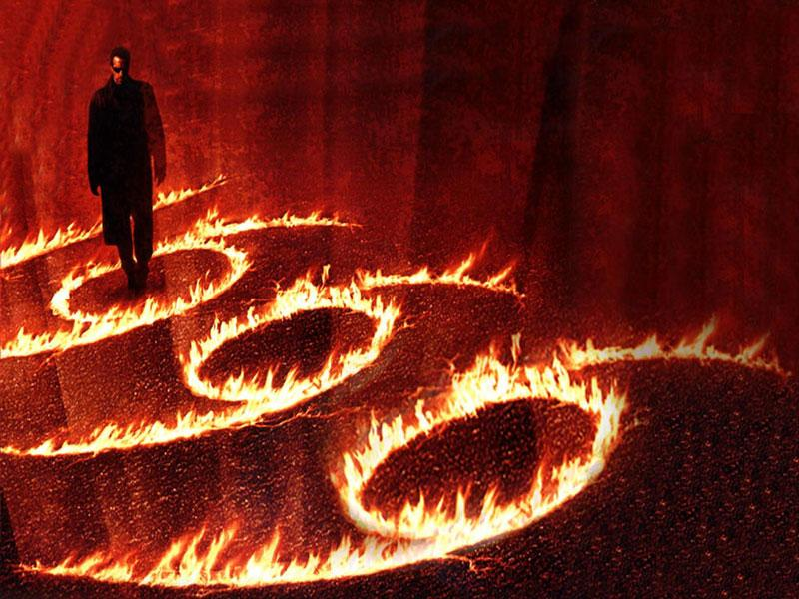
Rev. 13:18
478
Preterists see the number 666 in Rev. 13:18 as Nero, so Revelation must have been written during Nero's time

Slide 28
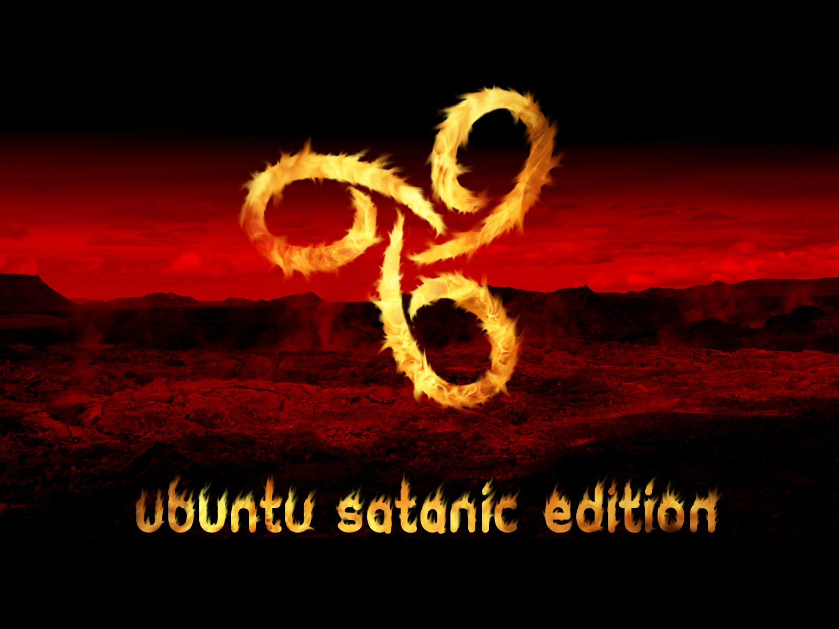
Response: Future Orientation
478
Rev. 1:1 and 4:1 state that John (the author) would be shown "what must soon take place" and "what must take place after this." This removes any doubt that the number of the beast must be future and not past or present.

Slide 29
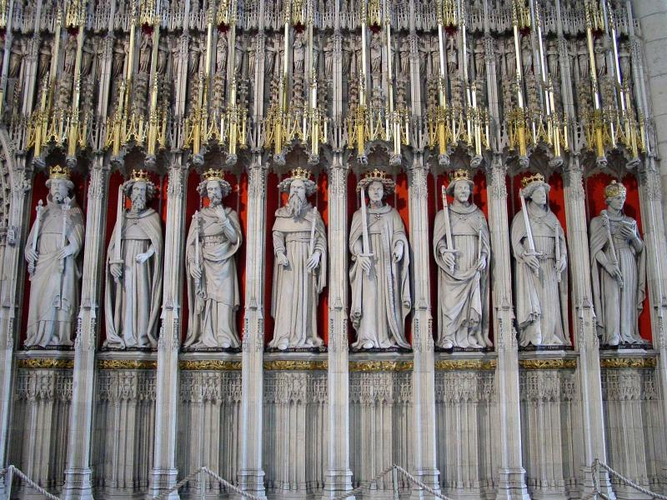
Rev. 17:10
478
Preterists see the "seven kings" as seven Roman kings from the first century. Then they argue that the sixth king is Nero.

Slide 30
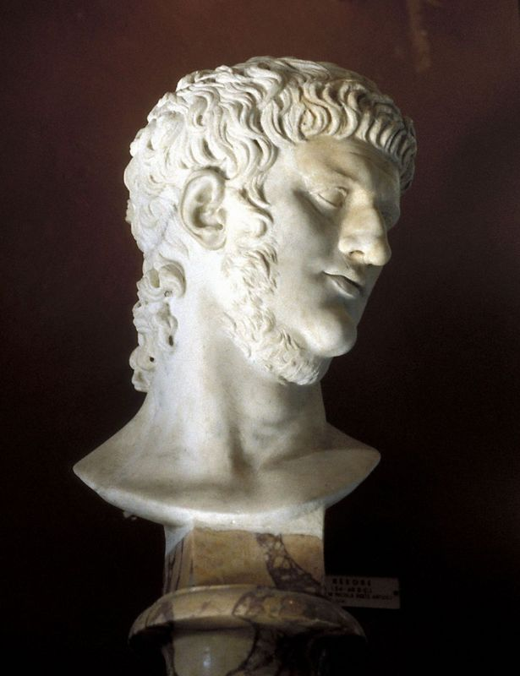
Response: Why can't Nero be the 666?
479
Nero exercised authority from AD 54-68, not for the required forty-two months
(Rev. 13:5).
All inhabitants of the earth did not worship Nero (Rev. 13:8).

Slide 31
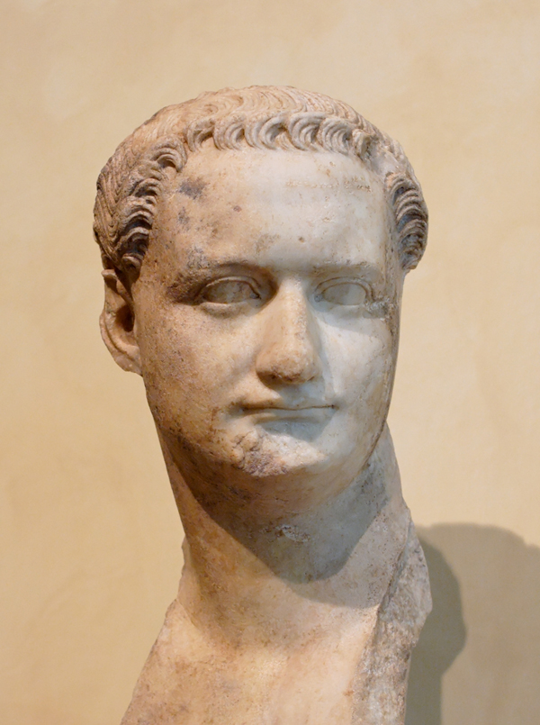
Rev. 17:10 has no reference to Nero or Domitian as Beale affirms.
480
Nero (AD 54-68)
Domitian (AD 81-96)

Slide 32

Correlation with Daniel
479
Daniel 7:1-8 | Revelation 13:1-2; 17:9-12
Four beasts (lion, bear, leopard, terrible beast with ten horns) | One beast that is like a leopard, bear, and lion (13:2) with ten horns (13:1; 17:3)
Seven heads representing four successive kingdoms | Seven heads representing seven successive kingdoms
Four kingdoms | Seven kingdoms
Ten horns (v. 7) | Ten horns (13:1; 17:3,12)
Mark L. Hitchcock, "A Critique of the Preterist View of Revelation 17:9-11 and Nero," Bibliotheca Sacra 164 (July-September 2007): 484

Slide 33
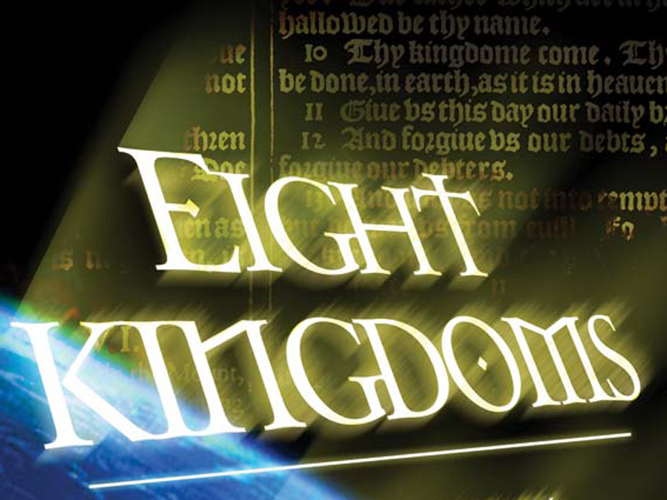
Eight Successive Kingdoms (17:10-11)
479
Egypt (Pharaohs)
Assyria (Assyrian kings)
3. Neo-Babylonia (Nebuchadnezzar)
4. Medo-Persia (Cyrus)
5. Greece (Alexander the Great)
6. Rome (Caesars; "one is")
7. Reunited Roman Empire (ten kings; "not yet")
8. Final Gentile world kingdom (the Antichrist)
Mark L. Hitchcock, "A Critique of the Preterist View of Revelation 17:9-11 and Nero," Bibliotheca Sacra 164 (July-September 2007): 484

Slide 34
Support for Successive Kingdoms View
479-480
"The successive-kingdoms view avoids the nebulous nature of the symbolic view, is consistent with the Old Testament imagery from Daniel 7, and provides a consistent interpretation of the eight kings. For these reasons this is the preferred view. Therefore Revelation 17:9-11 offers no support for the early date of Revelation based on the idea that Nero is the sixth king."
Mark L. Hitchcock, "A Critique of the Preterist View of Revelation 17:9-11 and Nero," Bibliotheca Sacra 164 (July-September 2007): 484

Slide 35

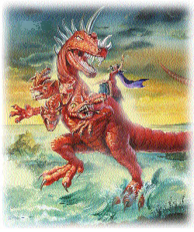

Control of the World Political System:
10
398
10
10
10
10
10
10
10
10
10
7 Heads
Roman
Consecutive
Past
17:9-11
10 Kings
Worldwide
Simultaneous
Future
17:12
Beast (8th King)
Worldwide
Controls 10 Kings
Future
17:13

Slide 36
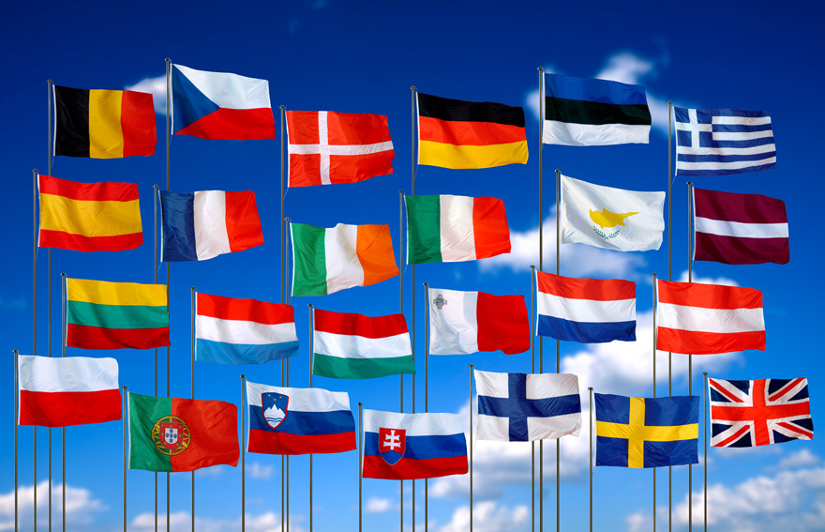
EU States
398

Slide 37
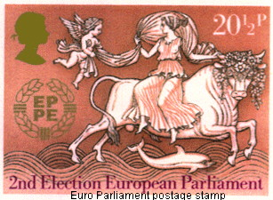
The European Parliament Official Stamp
398
BABYLON MYSTERY RELIGION TODAY

Slide 38
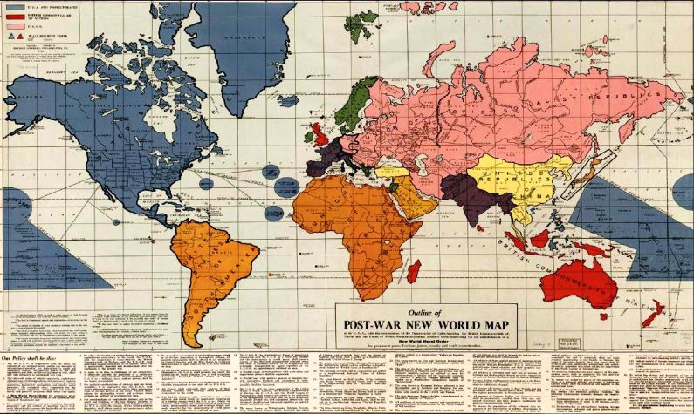
Proposed Post-War World II Map
398
Notes:
After WWII it was proposed to have the following structures:
1. A North American Union of States: This dominant world power that would include the US, Canada, all Central American and Caribbean states, most Atlantic islands (including Greenland and Iceland), most Pacific islands, Taiwan, Hainan, the Philippines and several now Indonesian islands, including Sulawesi. This was to be the dominant power in the world, military and otherwise.
2. A union of socialist republics led by Russia: The Soviet Union was to be rewarded with Persia (Iran), Mongolia, Manchuria, Finland, and all of Eastern Europe, which subsequently would form part of the Eastern Bloc (excluding Albania, but including the real-life maverick state of Yugoslavia, socialist but anti-Soviet) . All of theses states were simply to become member-states of the USSR. Austria and most of Germany, although 'quarantined' are shown within the Soviet sphere.
3.The United States of South America (USSA): including all South American states, as a single constituent state and the Falkland Islands as part of the USSA.
4. The Union of African Republics (UAR): All of Africa as a federation of republics.
5. The Arabian Federated Republics (AFR): covering Saudi and all other states now occupying the Arabian Peninsula, plus present-day Iraq and Syria.
6. The Federated Republics of India (FRI): Present day Afghanistan, Pakistan, India, Nepal, Bhutan, Bangladesh and Burma (Myanmar).
7. The United Republics of China (URC): A federation including all parts of present-day China, Korea, the erstwhile French colony of Indochina (now Vietnam, Laos and Cambodia), Thailand and Malaya.
8. The United States of Scandinavia (USS): Norway, Sweden, Denmark.
9. The United States of Europe (USE): the Benelux countries, the German Rhineland, France, Switzerland, Spain, Portugal and Italy.
10. And finally the British Commonwealth of Nations(BCN), including Great Britain,
Australia, New Zealand, Sri Lanka, Madagascar and most of Indonesia.
Smaller entities include Eire (the whole of Ireland), Greece (including Albania), Turkey (excluding European Turkey), Hebrewland (the Holy Land plus Jordan) and Japan. The three axis states (Germany, Italy and Japan) were to be 'quarantined' until they could be readmitted in the family of nations.
http://www.discerningtheworld.com/2012/01/31/10-kingdoms-the-abolition-of-sovereignty/#more-10755

Slide 39

Characteristics of Babylon
397
Babylon the Great
of the End Times
(Rev. 17–18)
What are her key characteristics?

Slide 40

Associations
End-Times Babylon (Prostitute)
(17:1–19:2)
399
at first
sits on (17:3)
later destroyed by beast (17:16)
Beast:
7 Heads
10 Horns
(17:3,12)
rules over (17:2)
desires to rule over (17:17)
Kings of the Earth
(17:2)
All Peoples of the Earth
(17:2, 15)

Slide 41
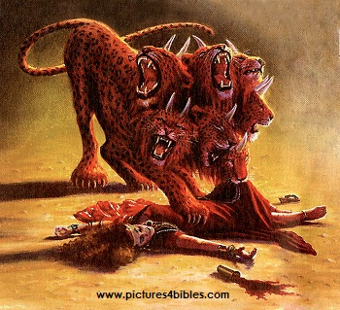
Associations
End-Times Babylon (Prostitute)
(17:1–19:2)
399
at first
sits on (17:3)
later destroyed by beast (17:16)
Beast:
7 Heads
10 Horns
(17:3,12)

Slide 42
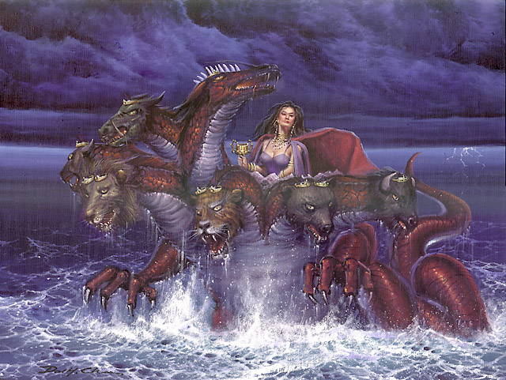
Views on End Times Babylon (The Harlot)
400
The World System
A Religion (Islam, Catholics, Astrology, One World Religion/New Age)
A City (Babylon, Rome, Jerusalem)
A Nation

Slide 43
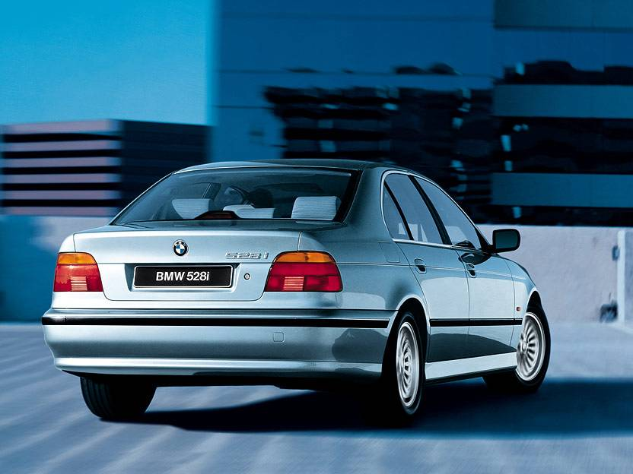


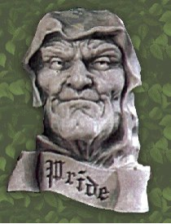

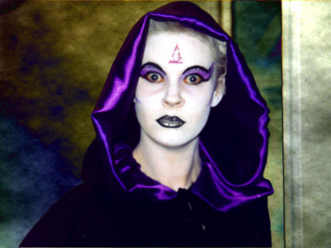
Is Babylon the…
400
World System?

Slide 44
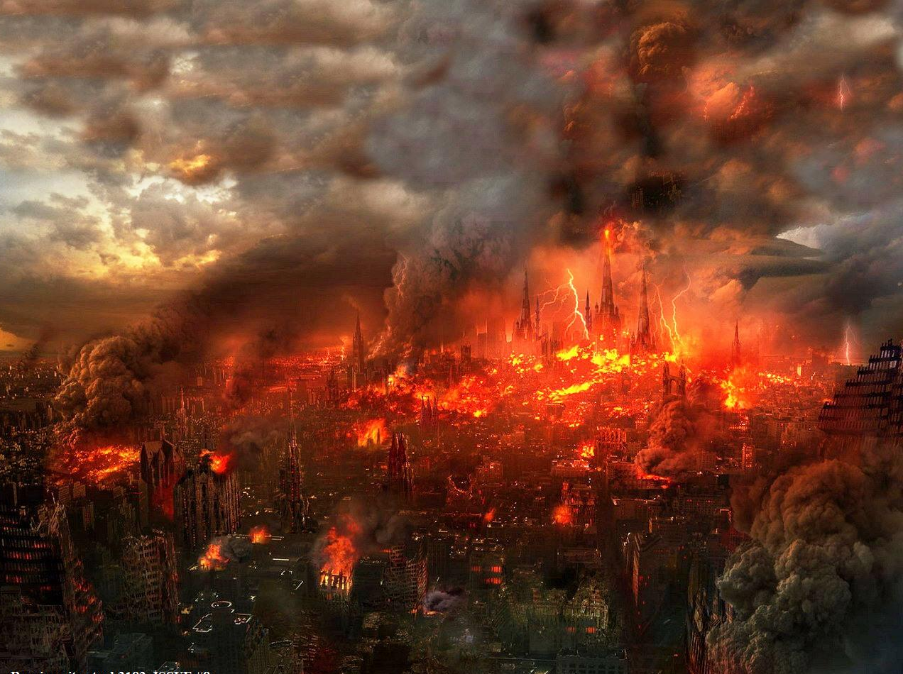
But Babylon Will Be Ruined in One Hour by Fire (18:10, 17, 19)
406
Pt. 6
How can people who are part of the world system stand off and mourn the demise of the world system (18:9-11)?
"In one hour such great wealth has been brought to ruin!"
(18:17a NIV)
Used with permission
Notes:
She will be completely destroyed by the Antichrist and his ten-nation confederacy (17:16a) by fire (17:16b; 18:8) in only one hour (18:10, 17, 19).

Slide 45
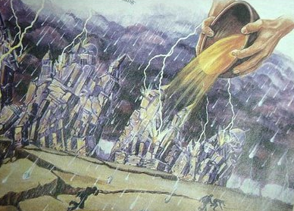
Bowl #7
(Rev. 16:18-19a NLT)
395
"Then the thunder crashed and rolled, and lightning flashed. And a great earthquake struck—the worst since people were placed on the earth. ¹⁹The great city of Babylon split into three sections, and the cities of [the] nations fell into heaps of rubble."
How can the world system break into three geographical sections?
Notes:
The cities of "many" (NLT) changed to the Greek text of "the cities of the nations…"

Slide 46

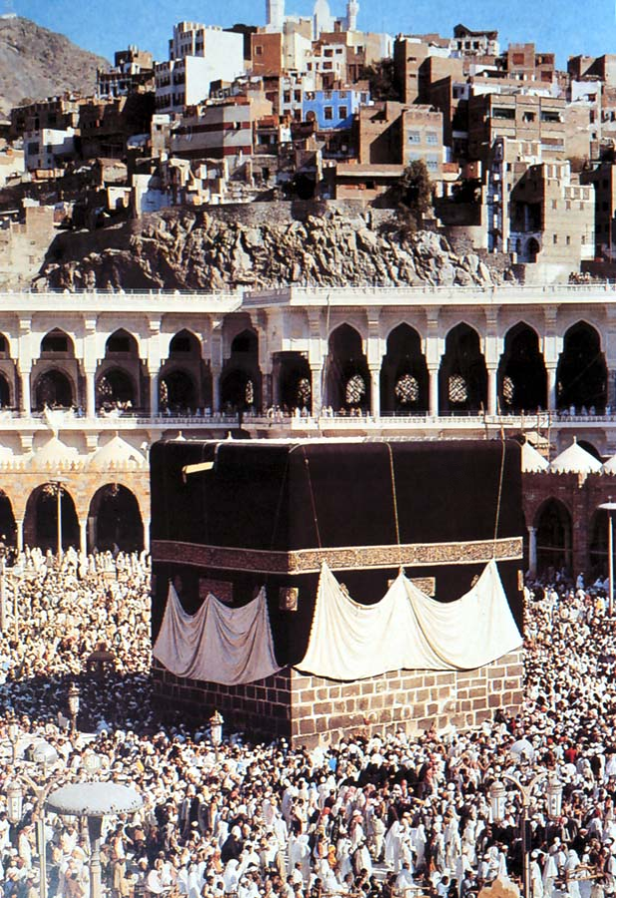
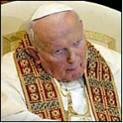
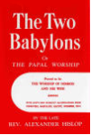
Is Babylon a Religion?
401
Islam

Slide 47
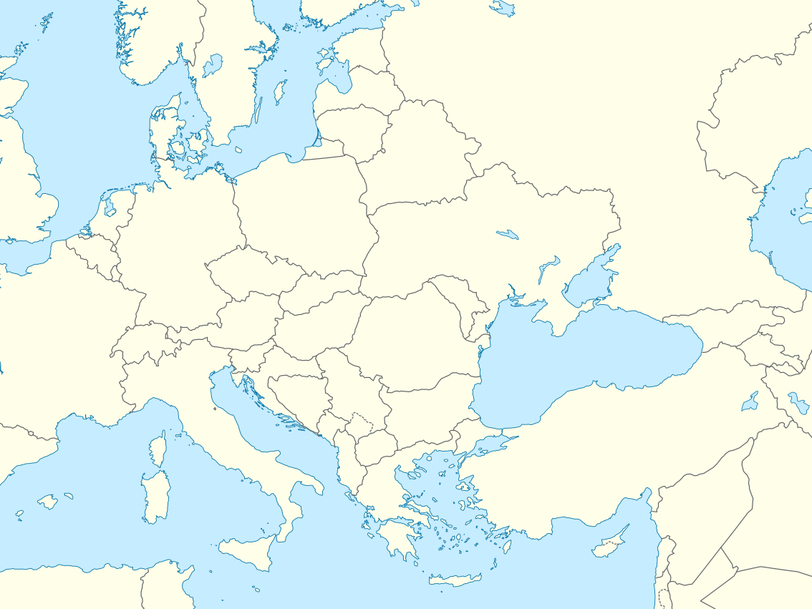
Babylon Religion Moved West
Rome
Pergamum
Babylon
Notes:
"After the Persians took over Babylon in 539 B.C., they discouraged the continuation of the mystery religions of Babylon. Subsequently the Babylonian cultists moved to Pergamum (or Pergamos) where one of the seven churches of Asia Minor was located (cf. Rev. 2:12-17)… When the teachers of the Babylonian mystery religions later moved from Pergamum to Rome, they were influential in paganizing Christianity and were the source of many so-called religious rites which have crept into ritualistic churches" (Walvoord, BKC).

Slide 48
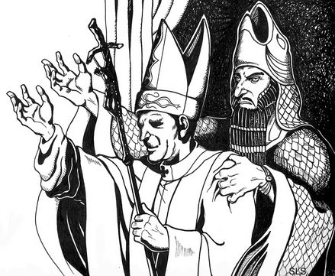
Babylon Religion Moved West
Pontifex Maximus
"Major Keeper of the Bridge"
"Keeper of the Bridge" between man and Satan
Rome
Pergamum
Babylon
Notes:
"Crowns in the shape of a fish head were worn by the chief priests of the Babylonian cult to honor the fish god. The crowns bore the words "Keeper of the Bridge," symbolic of the "bridge" between man and Satan. This handle was adopted by the Roman emperors, who used the Latin title Pontifex Maximus, which means "Major Keeper of the Bridge." And the same title was later used by the bishop of Rome. The pope today is often called the pontiff, which comes from pontifex. " (Walvoord, BKC).

Slide 49
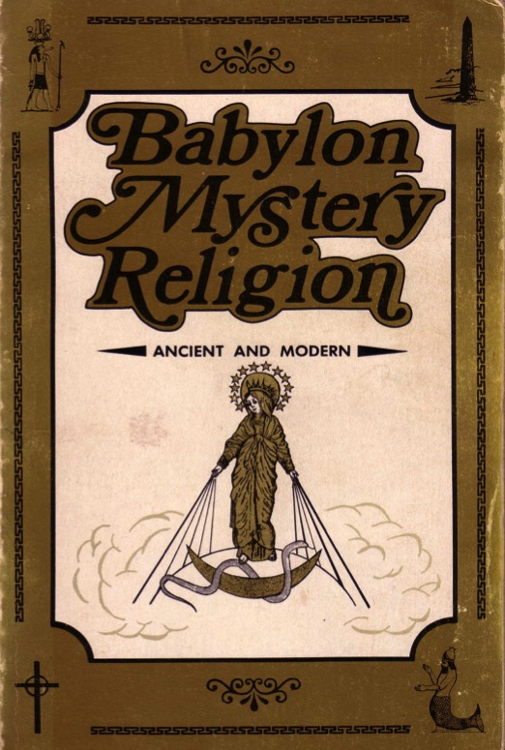
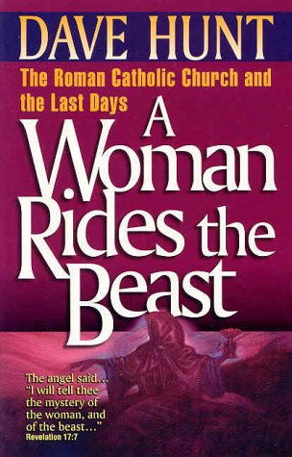
The Catholic Church Repeats Babylon's Mistakes
401
BABYLON MYSTERY RELIGION TODAY
Sources:
Ralph
Woodrow

Slide 50
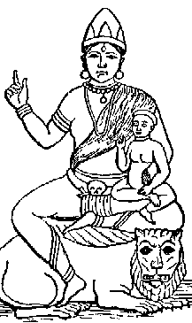
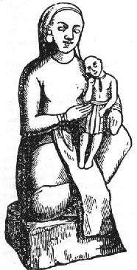
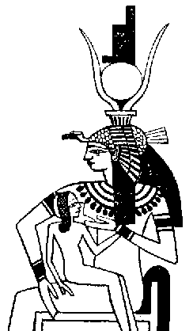
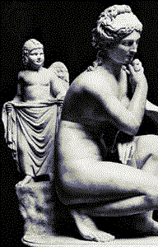
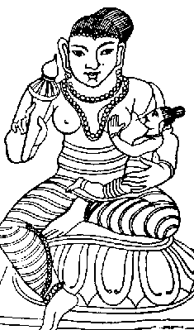
Mother and Child Worship
401
BABYLON MYSTERY RELIGION TODAY
Babylonians
The goddess mother Semiramis held her child Tammuz in her arms
Hindu
Greece
Babylon
Egypt
Buddhist

Slide 51
Mother and Child Worship
401
BABYLON MYSTERY RELIGION TODAY
Babylonians
The goddess mother Semiramis as wife of Nimrod was called the "Queen of Heaven"
Israel
Jeremiah 7:18 (NIV): "The [Jewish] children gather wood, the fathers light the fire, and the women knead the dough and make cakes of bread for the Queen of Heaven. They pour out drink offerings to other gods to provoke me to anger."
Notes:
Nimrod (Gen. 10:9-10) was the husband of Semiramis.

Slide 52
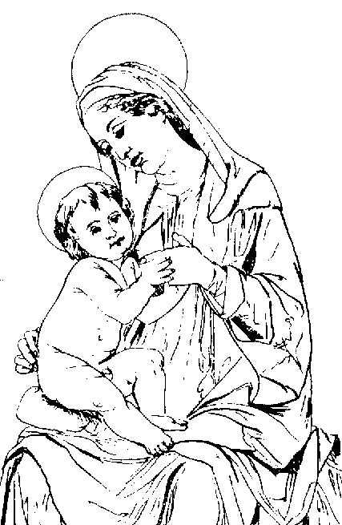
Mother and Child Worship
401
BABYLON MYSTERY RELIGION TODAY
Babylonians
The goddess mother Semiramis held her child Tammuz in her arms
Catholics
Mary is worshipped along with her son Jesus in the Babylonian fashion

Slide 53
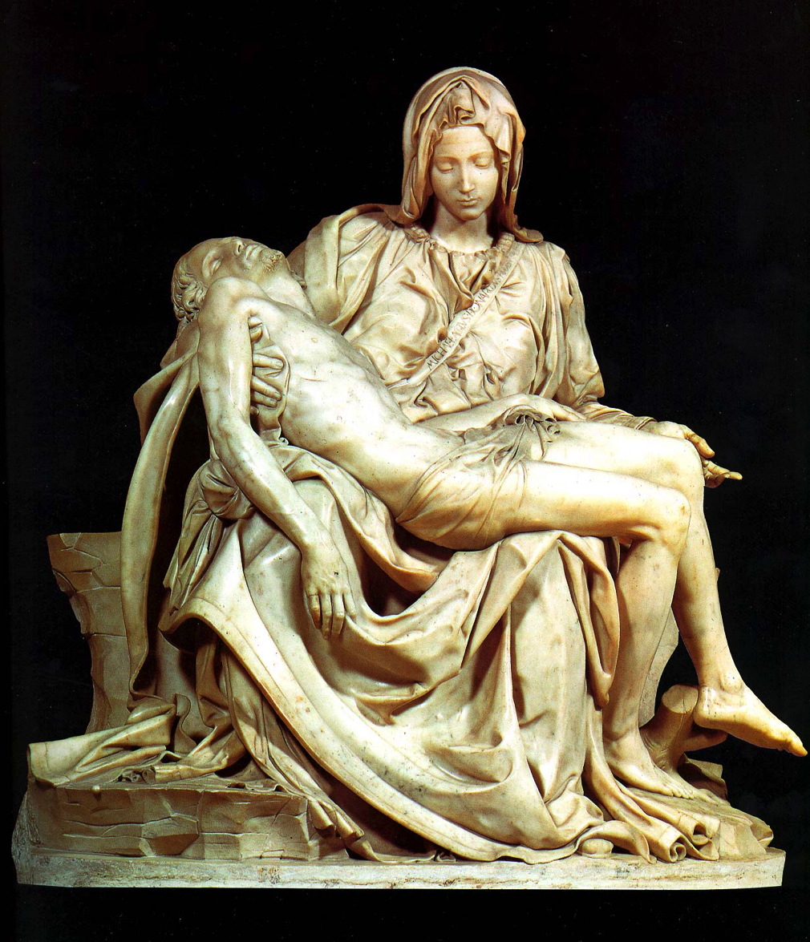
The Pieta
401
Who is the Focal Point of Michelangelo's Pieta?
Jesus is much smaller than Mary!

Slide 54
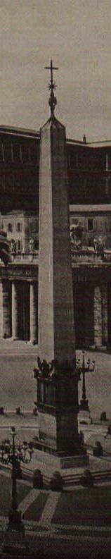

Obelisks
401
BABYLON MYSTERY RELIGION TODAY
Babylonians
Image
90 feet x 9 feet (Dan. 3)
Catholics
The emperor Caligula (AD 37-41) brought the obelisk to Rome from an Egyptian temple of sun-worship. Pope Sixtus V moved it to the Vatican in AD 1586 as the focal point of St. Peter's Square. He imposed the death penalty if it was broken!

Slide 55


The Egyptian Obelisk at St. Peter's Square
401
Notes:
The Washington Monument in Washington DC is also an obelisk with origins back to Babylonian Mystery Religion!

Slide 56
Other Pagan Parallels:
401
BABYLON MYSTERY RELIGION TODAY
Babylonians
Relics
Pilgrimages
Indulgences
Purgatory
Pontiffs
Celibate Priests
Transubstantiation
Easter Festival
Winter Festival
Catholics
Relics
Pilgrimages
Indulgences
Purgatory
Pontiffs
Celibate Priests
Transubstantiation
Easter Festival
Christmas Festival

Slide 57


Is Babylon Astrology?
402

Slide 58

One-World Religion
403

Slide 59

Apostate Church Centered in Rome
403

Slide 60


World Council of Churches
403

Slide 61

United Religions International formed on
26 June 2000 "to end religiously motivated violence"
404
Notes:
Recently (June 26, 2000), a charter was signed in Pittsburgh, Pennsylvania. An organization was born which was aptly named, United Religions. The purpose of this organization is to be the spiritual equivalent of the United Nations. Their purpose is to "to end religiously motivated violence" and "respect the uniqueness of each tradition. "While these ideas sound lofty and exalted, they also assert "Members of the URI shall not be coerced to participate in any ritual or be proselytized." Members of this organization come from a variety of traditions, as evidenced by their emblem above. This is not a Biblically based doctrine, which would say "for there is none other name under heaven given among men, whereby we must be saved (Acts 4:12)." This is, indeed, the case. We must now allow ecumenism and interfaithism to destroy the foundation of a Biblically based belief in Jesus Christ as the Savior of the world. No other figure fulfills this position. Absolutely none other! This organization should not be endorsed by any Christian. It is just one in a series of steps that is paving the way for the Antichrist. www.pastorlewis.com/ uri/uri.html

Slide 62


Is Babylon a City?
404

Slide 63

A Dallas Seminary professor said the 1980s rebuilding of Babylon, Iraq revealed it as Mystery Babylon
404
Slide 2

Slide 64

The 1986 Babylon Medallion
404
110f
SADDAM HUSSEIN and the ancient world conqueror, Nebuchadnezzar. Not only did they look alike, but their mission was the same––to control the world. And the symbol of this world dominion is an ancient city…
BABYLON: Prelude to Armageddon?

Slide 65



Is Babylon a Code Name for Rome?
407

Slide 66

Rome had seven hills (17:9)
407

Slide 67


Is Babylon a Code Name for Jerusalem?
407

Slide 68


USA?
408
Dr. Chan Kai Lok says she is the USA

Slide 69

Babylon must be a nation. Why?
408
a
No single city in the world reigns over the earth (17:18)
A "city" is a nation in biblical symbolism

Slide 70

The USA is Symbolized by a Woman in the Statue of Liberty
408
b

Slide 71

End-Times Babylon is guilty of spiritual adultery. This means she left her godly heritage.
408
c

Slide 72

The USA began as a Christian nation
408
c

Slide 73

Plymouth Pilgrims
408
c

Slide 74

Yet they massacred the Pequot
408
c

Slide 75

The USA began as a Christian nation
408
c
The Declaration of Independence (1776) notes God 4 times
The Founding Fathers, early presidents, and the Supreme Court called the USA a "Christian nation" until 1947 (see http://www.afn.org/~govern/Christian_Nation.html)
The US sent the most missionaries in 1900s
"In God We Trust" is the national motto
The preamble of every single state among the 50 states appeals to God for help
Notes:
http://www.afn.org/~govern/Christian_Nation.html says…
WAS THE UNITED STATES FOUNDED AS A CHRISTIAN NATION?
Recently, many authors have debated whether or not the United States of America was founded as a Christian nation. I wish to provide a few historical quotes from our Founding Era that lend credence to the supposition that we indeed were founded as a Christian nation.
Granted, God is not mentioned in the Constitution, but He is mentioned in every major document leading up to the final wording of the Constitution. For example, Connecticut is still known as the "Constitution State" because its colonial constitution was used as a model for the United States Constitution. Its first words were: "For as much as it has pleased the almighty God by the wise disposition of His Divine Providence…"
Most of the fifty-five Founding Fathers who worked on the Constitution were members of orthodox Christian churches and many were even evangelical Christians. The first official act in the First Continental Congress was to open in Christian prayer, which ended in these words: "...the merits of Jesus Christ, Thy Son, our Savior. Amen". Sounds Christian to me.
Ben Franklin, at the Constitutional Convention, said: "...God governs in the affairs of men. And if a sparrow cannot fall to the ground without His notice is it probable that an empire can rise without His aid?"
John Adams stated so eloquently during this period of time that; "The general principles on which the fathers achieved Independence were ... the general principles of Christianity ... I will avow that I then believed, and now believe, that the general principles of Christianity are as etemal and immutable as the existence and attributes of God."
Later, John Quincy Adams answered the question as to why, next to Christmas, was the Fourth of July this most joyous and venerated day in the United States. He answered: "...Is it not that the Declaration of Independence first organized the social compact on the foundation of the Redeemer's mission upon earth? That it laid the cornerstone of human government upon the first precepts of Christianity?" Sounds like the founding of a Christian nation to me. John Quincy Adams went on to say that the biggest victory won in the American Revolution was that Christian principles and civil government would be tied together In what he called an "indissoluble" bond. The Founding Fathers understood that religion was inextricably part of our nation and government. The practice of the Christian religion in our government was not only welcomed but encouraged.
The intent of the First Amendment was well understood during the founding of our country. The First Amendment was not to keep religion out of government. It was to keep Government from establishing a 'National Denomination" (like the Church of England). As early as 1799 a court declared: "By our form of government the Christian religion is the established religion; and all sects and denominations of Christians are placed on the same equal footing." Even in the letter that Thomas Jefferson wrote to the Baptists of Danbury Connecticut (from which we derive the term "separation of Church and State") he made it quite clear that the wall of separation was to insure that Government would never interfere with religious activities because religious freedom came from God, not from Government.
Even George Washington who certainly knew the intent of the Constitution and the Bill of Rights, since he presided over their formation, said in his "Farewell Address": "Of all the dispositions and habits which lead to political prosperity, religion and morality are indispensable supports. In vain would that man claim the tribute of patriotism, who should labor to subvert these great pillars." Sure doesn't sound like Washington was trying to separate religion and politics.
John Jay, the first Chief Justice of the United States Supreme Court, and one of the three men most responsible for the writing of the Constitution declared:
"Providence has given to our people the choice of their rulers, and it is their duty-as well as privilege and interest- of our Christian nation to select and prefer Christians for their rulers." Still sounds like the Founding Fathers knew this was a Christian nation.
This view, that we were a Christian nation, was hold for almost 150 years until the Everson v. Board of Education ruling in 1947. Before that momentous ruling, even the Supreme Court knew that we were a Christian nation. In 1892 the Court stated:
"No purpose of action against religion can be imputed to any legislation, state or national, because this is a religious people...This is a Christian nation." There it is again! From the Supreme Court of the United States. This court went on to cite 87 precedents (prior actions, words, and rulings) to conclude that this was a "Christian nation".
In 1854, the House Judiciary Committee said: "in this age, there is no substitute for Christianity...That was the religion of the founders of the republic, and they expected it to remain the religion of their descendants.'
It should be noted here that even as late as 1958 a dissenting judge warned in Baer v. Kolmorgen that if the court did not stop talking about the "separation of Church and State", people were going to start thinking it was part of the Constitution.
It has been demonstrated in their own words: Ben Franklin, George Washington and John Adams, to the House of Representatives and the Supreme Court, how our founding fathers felt about the mix of politics and religion.
When we read articles such as "What's God got to do with it?" (Primack, 5/4) and "The wall between state and church must not be breached" (Tager, 5/7) it just reaffirms how little, even intelligent people, understand about the founding of our great Republic. To say that this nation was not founded as a Christian nation or that the Constitution was not founded on Christian principles is totally at odds with the facts of history.
Tex Browning
Back to Citizens for Better Government
Last Modified May 1, 2003

Slide 76

The USA began as a Christian nation
408
c

Slide 77


Do you trust in God?
Notes:
For over 200 years America has unashamedly declared trust in God in all forms of money--paper and coins alike. Since 1954 by law each currency and coin must say on it, "In God We Trust."

Slide 78

Do we trust in God?
Notes:
But do we really trust in God? (Click) I found it interesting that in 2007 the news broke that our new dollar coin produced in the previous month actually didn't have this phrase on the front or the back. Some have said that it didn't appear on the coin at all.

Slide 79


Does your trust in God embarrass you?
Notes:
But the phrase does appear--only it's on the side--at least on most of the 300 million coins minted! The news broke that an unknown amount of coins were missing the phrase totally. Interestingly, these coins are more valuable and at first sold for $600 on eBay. Now that we know there's as many as 100,000 of them, the price has dropped to $50. It seems that we are too embarrassed about Christ to put this phrase on the font or back anymore.

Slide 80

A Cause for Shame?
"Who, me? Well, I'm not saying that I am a Christian…
but I'm not saying that I'm not…"
Notes:
That reminds me of some Christians. Ask them if they are believers and they want to know why you want to know! Worse yet, they won't admit that they trust in Christ.

Slide 81

The USA began as a Christian nation but has left its godly heritage.
408
c
OBAMA EMAIL TO CBN NEWS
"WHATEVER WE ONCE WERE, WE'RE NO LONGER JUST A CHRISTIAN NATION; WE ARE ALSO A JEWISH NATION, A MUSLIM NATION, A BUDDHIST NATION, A HINDU NATION, AND A NATION OF NON-BELIEVERS…"

Slide 82


The USA began as a Christian nation but has left its godly heritage.
408
c
"We are no longer a Christian nation."
Barack Obama

Slide 83





The Christian heritage is now hotly debated!
408
c

Slide 84


USA Trade
408
d
Wall Street
WTO
Used with permission

Slide 85



Trade of Tyre
(Isaiah 23)
Imported raw materials from faraway countries and exported finished products:
Bronze – exported to Assyria, Cyprus, Greece, and Italy
Ivory – imported from Syria then exported finished products to the west
Also glass workings, wool stuffs dyed in purple, etc.

Slide 86


Phoenician Colonies
EUROPE
(Tarshish)
ASIA MINOR
AFRICA
Phoenician Shipping Routes
Land of Phoenicia
Trade Routes

Slide 87

The Trade of Phoenicia
Commercially astute: used trade treaties & political alliances:
Trade with David (2 Sam. 5:11; 1 Kings 5:1)
King Hiram helped Solomon in building and overseas ventures
Export of oil, wine and timber
Called a harlot (Isa. 23:16-17)

Slide 88


USA Wealth
409
e
Total Net Worth of US Households and Nonprofit Organizations 1945-2009
70
65
60
55
50
45
40
35
Trillions of Dollars
30
25
20
15
10
5
0
Used with permission

Slide 89


USA Wealth
409
e

Slide 90

US Control of Other Nations
409
f
Used with permission

Slide 91

US Could Be Destroyed by Russian Nukes
409
g
Used with permission

Slide 92


US Hedonism
409
h
Hedonism
Apologize for Nothing
Used with permission

Slide 93

US Glorified
410
i
Used with permission

Slide 94


US Occultism
410
j
Used with permission

Slide 95





US Immorality
410
k

Slide 96

US Deceives All Nations with Her Sorcery
411
l
"Your merchants were the great men of the earth, because all the nations were deceived by your sorcery (farmakei,a )" (18:23b NAU)

Slide 97



US Deceives All Nations with Her Sorcery
411
l

Slide 98

US Sits as a Queen
411
m
"She glorified herself and lived in luxury,
so match it now
with torment and sorrow.
She boasted in her heart,
'I am queen on my throne.
I am no helpless widow,
and I have no reason
to mourn'" (18:7 NLT)
Used with permission

Slide 99
Godless Philosophy
411
n
"God is dead."
– Nietzsche, 1883
"Nietzsche is dead."
– God, 1900
Used with permission

Slide 100

US Killed Prophets of God
411
n
How many prophetic voices has America murdered through abortion?
Answer:
> 55 million
Used with permission

Slide 101
Problems with the USA as Mystery Babylon
412
The national symbol of the USA is not a woman but the bald eagle
Claims that Russia is the beast must be proven
The destruction of the USA in 1993 didn't occur, as well as other "prophetic" blunders
Dr. Chan's book has many other theological problems
Used with permission

Slide 102

What or Who, then, is
Mystery Babylon?
412
No one can identify the Babylon of Revelation 17–18 with certainty.
However, it is unlikely that it is the world system, a city or confederation of nations.
The USA may be the
best option at present, but
no one really knows
—including me!
Used with permission

Slide 103

Antichrist will destroy End Times Babylon when he heads a confederacy of ten regions in the second half of the Tribulation (17:7-18).
7 Heads & 10 Horns
Used with permission

Slide 104
Eight Successive Kingdoms (17:10-11)
479
Egypt (Pharaohs)
Assyria (Assyrian kings)
3. Neo-Babylonia (Nebuchadnezzar)
4. Medo-Persia (Cyrus)
5. Greece (Alexander the Great)
6. Rome (Caesars; "one is")
7. Reunited Roman Empire (ten kings; "not yet")
8. Final Gentile world kingdom (the Antichrist)
Mark L. Hitchcock, "A Critique of the Preterist View of Revelation 17:9-11 and Nero," Bibliotheca Sacra 164 (July-September 2007): 484

Slide 105

At first she rides the beast
(17:7-14)
Used with permission

Slide 106

But later the beast kills her (17:15-18)

Slide 107
I. This world's key entity will fall in the Tribulation (Rev. 17).
What will happen to the world's most evil influence?

Slide 108


II. The world's key influence will be replaced with Christ's kingdom (18:1–19:10).
Why reject the world and embrace God's kingdom?

Slide 109

"After all this I saw another angel come down from heaven with great authority, and the earth grew bright with his splendor.
²He gave a mighty shout"
(18:1-2a NLT).

Slide 110

"Babylon is fallen—that great city is fallen!
She has become a home for demons.
She is a hideout for every foul spirit, a hideout for every foul vulture and every foul and dreadful animal.
³For all the nations have fallen because of the wine of her passionate immorality. The kings of the world have committed adultery with her. Because of her desires for extravagant luxury, the merchants of the world have grown rich" (18:2b-3 NLT).

Slide 111

"Come out of her" (18:4)

Slide 112

"Then I heard another voice calling from heaven, 'Come away from her, my people.
Do not take part in her sins, or you will be punished with her.
⁵For her sins are piled as high as heaven, and God remembers her evil deeds.
⁶Do to her as she has done to others.
Double her penalty for all her evil deeds.
She brewed a cup of terror for others, so brew twice as much for her.
⁷She glorified herself and lived in luxury, so match it now with torment and sorrow'"
(18:4-7a NLT).

Slide 113

"Come out of her" (18:4)

Slide 114

Earth Mourns (18:9-24)
414
Used with permission

Slide 115

"And the kings of the world who committed adultery with her and enjoyed her great luxury will mourn for her as they see the smoke rising from her charred remains.
¹⁰They will stand at a distance, terrified by her great torment. They will cry out,
'How terrible, how terrible for you,
O Babylon, you great city!
In a single moment
God's judgment came on you' "
(18:9-10 NLT).

Slide 116

Businessmen will mourn (18:11)
"Too bad, too bad," say the merchants

Slide 117

Babylon Will Be Ruined in One Hour by Fire (18:10, 17, 19)
406
Pt. 6
"In one hour such great wealth has been brought to ruin!"
(18:17a NIV)
Used with permission
Notes:
She will be completely destroyed by the Antichrist and his ten-nation confederacy (17:16a) by fire (17:16b; 18:8) in only one hour (18:10, 17, 19).

Slide 118

Babylon Destroyed Quickly
406
Pt. 6
"Then a mighty angel picked up a boulder the size of a huge millstone. He threw it into the ocean and shouted, 'Just like this, the great city Babylon
will be thrown down with violence
and will never be found again' " (18:21 NLT).
Notes:
She will be completely destroyed by the Antichrist and his ten-nation confederacy (17:16a) by fire (17:16b; 18:8) in only one hour (18:10, 17, 19).

Slide 119

The Harlot Will Sink…

Slide 120

"The light of a lamp will never shine in you again. The happy voices of brides and grooms will never be heard in you again. For your merchants were the greatest in the world, and you deceived the nations with your sorceries" (18:23 NLT).

Slide 121

"In your streets flowed the blood of the prophets and of God's holy people and the blood of people slaughtered all over the world"
(18:24 NLT).

Slide 122


Heaven Rejoices (19:1-2 NLT)
414
"After this, I heard what sounded like a vast crowd in heaven shouting,
'Praise the LORD!
Salvation and glory and power belong to our God.
²His judgments are true and just.
He has punished the great prostitute
who corrupted the earth with her immorality.
He has avenged the murder of his servants.'"
Used with permission
Notes:
"God has been reigning on the throne of heaven, but He is now about to conquer the thrones of earth as well as the kingdom of Satan and "the beast." In His sovereignty, He has permitted evil men and evil angels to do their worst; but now the time has come for God's will to be done on earth as it is in heaven. Domitian was emperor of Rome when John was on Patmos, and one of his assumed titles was "Lord and God." How significant it must have been, then, to John's readers that he used the word alleluia four times in the first six verses of this chapter—truly, only Jehovah is worthy of worship and praise" (Wiersbe).

Slide 123

"And again their voices rang out:
'Praise the LORD!
The smoke from that city ascends forever and ever!"
(19:3 NLT).
Used with permission

Slide 124

The Marriage & Wedding Supper of the Lamb
415
Notes:
124

Slide 125

The Invitation in Revelation 19:7-9 (NAU)
    ⁷ "Let us rejoice and be glad and give the glory to Him, for the marriage of the Lamb has come and His bride has made herself ready.
    ^{8 "}It was given to her to clothe herself in fine linen, bright and clean; for the fine linen is the righteous acts of the saints.
⁹ "Then he said to me, 'Write, "Blessed are those who are invited to the marriage supper of the Lamb."' And he said to me, 'These are true words of God.'"
415
Notes:
125

Slide 126

"Pre-Trib" Rapture
416
Second Coming
Rapture
(Wedding)
(Supper)
Tribulation
Millennium
Church Age
Eternal Kingdom
7 years
1000 years
Judgment
Notes:
126

Slide 127
The Marriage & Supper Contrasts (19:7-9)
416
Symbols | Wedding | Feast
Verse | 7 | 9
Tense | Aorist (past) | Present
Involvement | Church as Bride | Israel as Guests
Time Period | Tribulation | Millennium
Place | Heaven | Earth
Characteristics | Procession, Wedding | Friends invited to Wedding Feast
Explanation | Bride/Church brought to Father's house | Bride/Church introduced to friends/Israel
Scripture | Rom. 7:1-4; 1 Cor. 6:17; 2 Cor. 11:2; Eph. 5:27 | Isa. 25:6-8; Matt. 8:11; 26:29; Luke 12:35-37
Notes:
127
NLT adds "feast" to 19:7

Slide 128

Main Idea:
This world won't last
but Christ's kingdom will!

Slide 129

Babylon will not last!

Slide 130

Christ's Kingdom will last!

Slide 131
I. This world's key entity will fall in the Tribulation (Rev. 17).
What will happen to the world's most evil influence?

Slide 132
II. The world's key influence will be replaced with Christ's kingdom (18:1–19:10).
Why reject the world and embrace God's kingdom?

Slide 133

"Come out of her" (18:4)

Slide 134

How do you need to "Come out of her"?
"His bride has made herself ready"
(19:7 NIV)

Slide 135


Jeremiah's Application: "Leave Jerusalem"
Jeremiah 24 portrayed all the Jews as two types of figs during Babylon's siege:
The "bad figs" who refused to submit to God's discipline by the Babylonians would disobey God by staying in the city and dying.
The "good figs" would spare their lives by leaving the city to surrender to the Babylonians outside!
AD 70 was no different!
Jews as figs:
good
bad
Babylonians
Jeremiah 24 Figs

Slide 136


Hebrew's Application: "Leave Jerusalem"
"So also Jesus suffered and died outside the city gates to make his people holy by means of his own blood"
(Heb. 13:12 NLT)
¹³ So let us go out to him, outside the camp, and bear the disgrace he bore"
(Heb. 13:13 NLT)
Leen & Kathleen Ritmeyer, "Akeldama: Potter's Field or High Priest's Tomb?" BAR 20 (Nov/Dec 94): 34

Slide 137

How do you need to "Come out of her"?
Your eyes
Your ears
Your lips
Your hands
Your feet

Slide 138

7 Heads & 10 Horns
Used with permission

Slide 140

Jesus Wins!
Series on Revelation

Slide 141


NT Preaching link at BibleStudyDownloads.org
Get this presentation and script for free!
Notes:
NT Preaching (np)

